Slide 1
REPORT ON STAR WARS FOR LUCAS FILMS & PRODUCTIONS BY OGUNDIPE AYOMIDE
INSIGHT TO IMPROVE QUALITY, PROCESSES AND FINANCE.
DATED
SATURDAY, 12 MARCH, 2022.

Slide 2
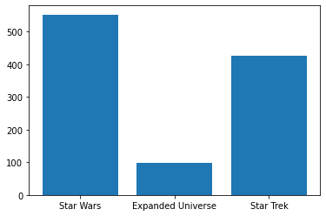
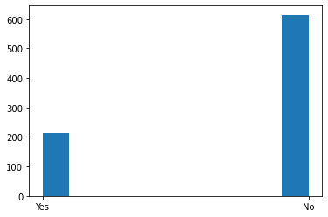
COMPARISON OF FANS From the bar chart below, it can be seen that star wars has the highest number of fans and expanded universe has the least amount of fans. It is therefore adviseable that lucas films & productions, produce more of star wars movies.
The expanded universe also, the chart below is an histogram of people familiar with the expanded universe. It can be deduced that a larger percentage of viewers aren’t familiar with it, this is a more concrete reason to support why more of star war movies should be produced.
Are you familiar with the Expanded Universe?

Slide 3
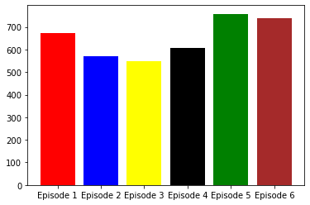
MOST SEEN STAR WARS FILM
From the barchart below, it can be seen vividly that Episode 5 which is titled Star Wars: The Empire Strikes Back is the most seen/viewed star wars film totalling 758 viewers out of 935 viewers. Since this was mostly seen, more productions of it would generate more income for Lucas Films & Productions as a lot people of people are likely to view it more.
STAR WARS EPISODES | Episode 1 | Episode 2 | Episode 3 | Episode 4 | Episode 5 | Episode 6
NO OF VIEWERS | 673 | 571 | 550 | 607 | 758 | 738

Slide 4
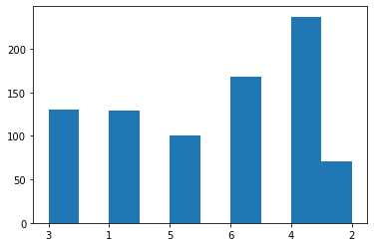
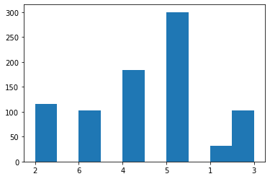
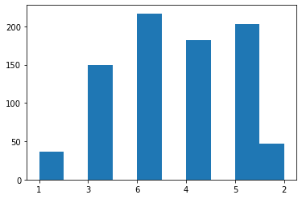
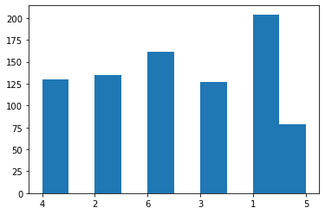
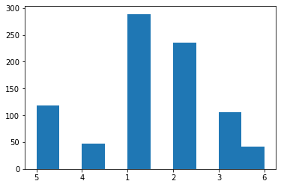
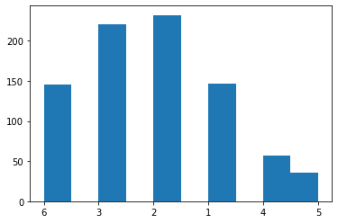
STARWARS - FILM RANKS, continued in next slide
EPISODE 1
EPISODE 2
EPISODE 3
EPISODE 4
EPISODE 5
EPISODE 6

Slide 5
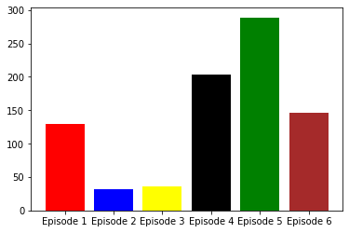
Best rated starwars film Below is the barchart comparing the films using the respective favorite of rank 1 to get the best rated episode. Vividly, episode 5 is ranked as the most favorite film in the starwars franchise film. Also, from slide three, episode 5 was the most seen star wars film. With episode 5 being the most viewed and most favorite , locas films & PRODUCTIONS CAN PUT OUT MORE FILM PRODUCTIONS LIKE THIS, AS IT WOULD AID THE QUALITY OF WORK BEING PRODUCED AND IN TURN BOOST THE FINANCES OF YOUR FIRM.

Slide 6
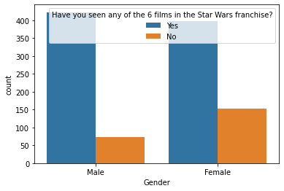
TARGET AUDIENCE From the countplot below, it can be inferred that more of the male gender view star wars films, we can then focus more of our marketing towards the male gender than the female gender.

Slide 7
THANK YOU!
These are some of the inferences and observations made from the data. More inferences that can be made from the data given would be communicated in due time.

